Slide 1
Graduation Research CSCI 4108
Introduction

Slide 2
Outline
Group Formation
Capstone Project
Why research in IT Matters?
Some Subject Areas
Select a research topic
Project types
Project Idea assessment
Problem Statement
Roles and Duties

Slide 3

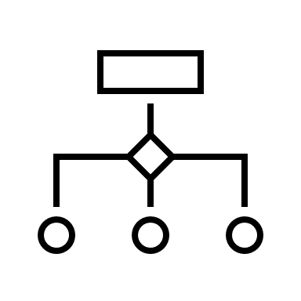



Reminder – Group Formation
1st Semester
2nd / summer Semester
Graduation Research CSCI4108
Form Group, choose a topic & a supervisor.
Project Proposal report: Abstract, Introduction, Problem Statement, Related Works, ….
Graduation Research CSCI4208
Same Group, topic & supervisor.
Implement Project + write “Graduation Report” (same as proposal + additional chapters and sections).

Slide 4
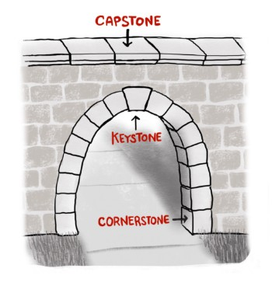
Capstone Project

Slide 5
Importance of graduation project
Opportunity to demonstrate knowledge & skills you have acquired
Project Management
Analytical Skills – taking a complex problem and devising a practical solution
Communication Skills – preparation of web sites, reports and a presentation
The successful completion of graduation project is a sing of the students’ readiness to pursue a professional career

Slide 6

What is research?
Pose questions and find information

Slide 7
What is Research?
Research is a systematic and organized process of inquiry, investigation, or exploration that is conducted to discover, interpret, analyze, and gain knowledge or insights into a specific topic, issue, question, or phenomenon.

Slide 8

Why Research in IT Matters?
Significance of research skills in the IT field.
Advancements in technology rely on research.
Research skills enhance problem-solving abilities.
IT professionals with research skills are in high demand.
Importance of choosing the right research topic.
Align with your interests and career goals.
Contributes to the field of IT.

Slide 9

Why Research in IT Matters?
Driving Technological Advancements and make Innovation and Breakthroughs
Solving Real-World Complex Problems
Staying Competitive
Continuous Learning

Slide 10









Contribute…. – Business started by students at University

Slide 11
Why Research in IT Matters? – the summary
Research in IT matters because it drives technological progress, equips individuals with problem-solving skills, meets industry demands, ensures competitiveness, fosters continuous learning, leads to innovation, and addresses real-world challenges.
It's a fundamental component of the Information Technology field and has a significant impact on both individuals and society.

Slide 12







Subject Area
Software Development:
Create a mobile app or web application to solve a specific problem or address a particular need.
Contribute to an open-source project by adding new features or fixing bugs.
Develop an AI-powered chatbot for customer support.
….
E-commerce and Online Business:
Develop an e-commerce website with advanced features like personalized recommendations and real-time inventory management.
Optimize the checkout process to reduce cart abandonment rates.
Create a business intelligence dashboard for tracking e-commerce metrics.
…

Slide 13








Subject Area
Health IT:
Design and build a telemedicine platform for remote patient consultations.
Develop a healthcare data management system for electronic health records (EHR).
Implement a wearable device for health monitoring and data collection.
…
AR / VR applications
Create a VR-based training application for a specific industry, like aviation, healthcare, or manufacturing, which includes 3D simulations, audio, and interactive elements for hands-on learning.
Build an AR mobile app that provides an immersive tourism experience. Users can point their smartphone or AR glasses at landmarks, and the app overlays multimedia information, historical facts, and virtual tour guides.
….

Slide 14








Subject Area
Interactive Educational Website:
Develop an interactive educational website that uses multimedia elements such as videos, animations, and interactive quizzes to teach a specific subject, like coding, science, or history.
Use AR and VR in education
….
Video Game Development:
Develop a video game that incorporates multimedia elements, including 3D graphics, sound effects, and music. This could involve creating an original game or enhancing an existing one.
….

Slide 15



Subject Area
Multimedia Documentary Project:
Create a multimedia documentary on a relevant and meaningful topic, combining video interviews, animations, infographics, and interactive elements to engage and inform viewers.
…
Blockchain and Cryptocurrency:
Design and implement a blockchain-based supply chain management system.
Explore the use of blockchain for secure voting systems.
…

Slide 16



Subject Area
Multimedia Content Recommendation System:
Develop a recommendation system that suggests multimedia content (videos, music, articles) to users based on their preferences and viewing history.
Multimedia Search Engine:
Build a search engine that can index and search multimedia content, including images, videos, and audio clips, using advanced algorithms like image recognition and natural language processing.
Multimedia Data Mining and Analysis:
Create a system that mines multimedia data (images, videos, social media content) to extract valuable insights, trends, or sentiment analysis for marketing or research purposes.

Slide 17








Subject Area
Gesture Recognition and Control:
Design a system that uses computer vision and machine learning to recognize and interpret gestures, allowing users to control applications or devices through hand or body movements.
…..

Slide 18
Selecting a Research Topic
Students (strongly encouraged)
Students are advised to discuss their own project idea with the faculty members in the college for potential supervision
Faculty members
Based on their expertise, faculty members would propose several projects they are willing to supervise; Students may bid to join such projects
External partners
Students may choose to work with our industry partners on their sponsored projects

Slide 19
Project types
Generic applications
Customized application

Slide 20
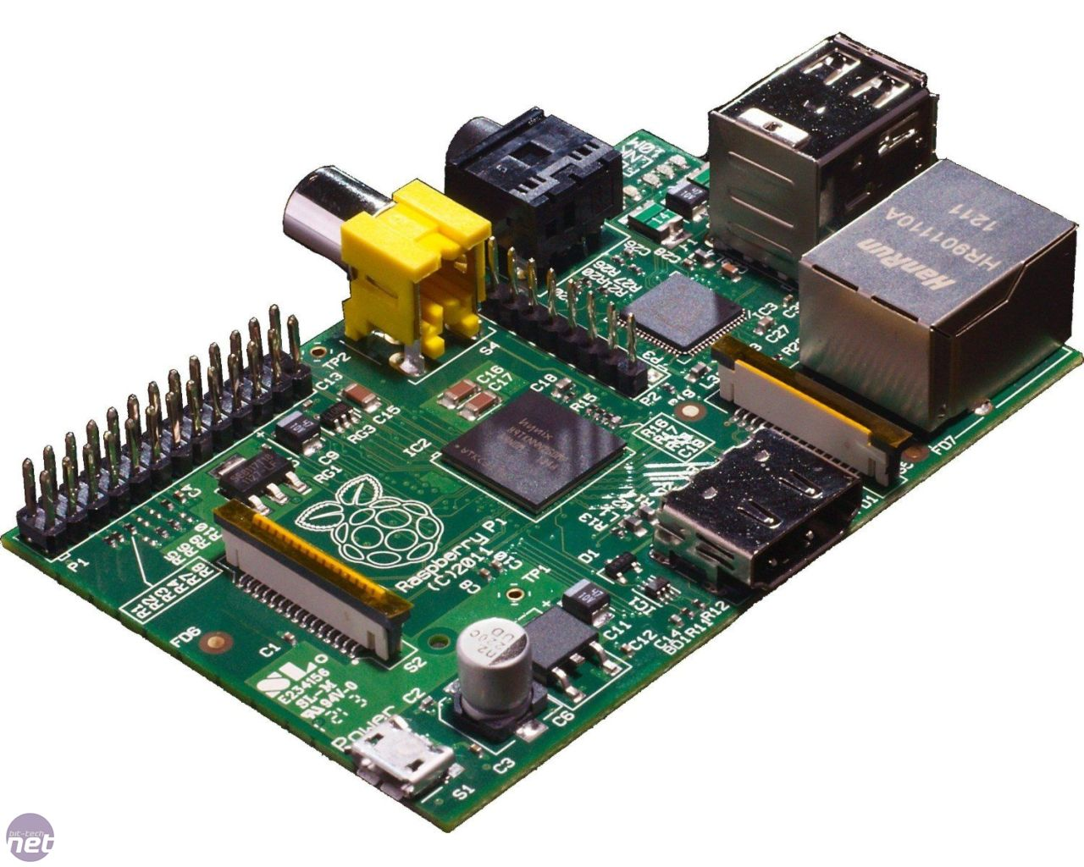

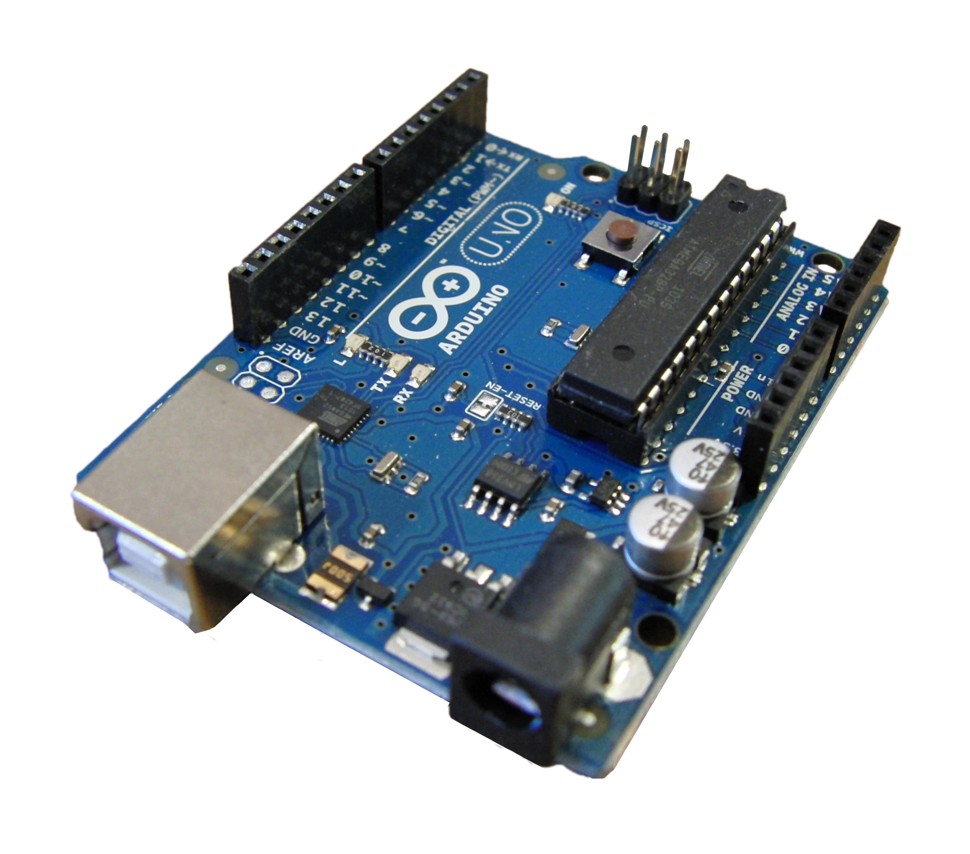
Target platform
Desktop
Mobile
Web
Raspberry Pi / Arduino

Slide 21
Project Idea Assessment
Within Your Interests
Pursue Current Trends
Has A Practical Significance
Reviewed Existing Literature
Narrowed Your Focus
Considered Feasibility
Think About Long-Term Goals
Passion and Curiosity

Slide 22
Ask for advice
Consult with Professors and Peers
Stay Open to Adaptations
Notes:
Understand Your Interests:
Start by reflecting on your interests within the broad field of IT. Consider the aspects of IT that genuinely fascinate you.
Research is more enjoyable and productive when you're passionate about the topic.
Identify Current Trends:
Stay informed about current trends and emerging technologies in IT. Subscribe to IT news sources, journals, and blogs.
Identifying trends can help you select a research topic that is relevant and impactful.
Consider Practical Significance:
Think about the practical significance of your research. How might your work contribute to solving real-world problems or improving IT systems?
Topics with practical applications tend to be more meaningful.
Review Existing Literature:
Conduct a preliminary literature review. Look for gaps in the existing research where your contribution could fill a void.
This ensures that your research is both novel and relevant.
Consult with Professors and Peers:
Seek guidance from professors, mentors, or peers in the IT field. They can provide insights and suggestions for research topics.
Don't hesitate to discuss your ideas and gather feedback.
Narrow or Broaden Your Focus:
Depending on the scope of your research course or project, you may need to narrow or broaden your topic.
Consider the available time and resources for your research.
Consider Feasibility:
Evaluate the feasibility of your chosen topic. Can you access the necessary data, tools, and resources for research?
Ensure that your topic is manageable within your constraints.
Think About Long-Term Goals:
Consider how your chosen topic aligns with your long-term academic or career goals. Will it provide valuable expertise or open doors in your desired field?
Stay Open to Adaptations:
Be open to adapting your research topic as you delve deeper into the literature and gather more information.
Sometimes, your initial idea may evolve into a more refined topic.
Passion and Curiosity:
Ultimately, choose a research topic that genuinely excites your curiosity and passion. Research is a journey, and enthusiasm will sustain you through it.
Remember that selecting a research topic is a dynamic process. It may take time to find the right one, so be patient and open to exploration. Your choice of topic is the foundation of your research, so invest time and effort in making an informed decision.

Slide 23
Formulating a Research Problem
Start with a Broad Idea
Narrow Down the Focus
Consider the "5 Ws" and "H“
Use the "5 Ws" (Who, What, Where, When, Why) and "H" (How) to guide your thinking.
For example, "Who is affected by the problem? What is the nature of the problem? Where does it occur? When is it most prevalent? Why does it matter? How can it be addressed?"
Review Existing Literature

Slide 24
Formulating a Research Problem (Cont.)
Consider the Impact
Make It Specific and Clear
Articulate as a Question or Statement
Seek Feedback
Revise and Refine
Write a Problem Statement

Slide 25
Formulating a Research Problem (Cont.)
Well-formulated research problem is the foundation of your research project.
It guides your research design, data collection, analysis, and ultimately, the contribution your research makes to the field of IT.
Take the time to craft a problem statement that is both meaningful and researchable.

Slide 26
Project Problem statement Examples
Development of a Mobile Banking App
Problem Statement: "The current mobile banking apps lack essential features, leading to low user satisfaction and limited adoption. The project aims to develop a user-friendly and feature-rich mobile banking app that provides secure, convenient, and efficient banking services to customers.“
Website Redesign for E-commerce Business
Problem Statement: “Company X e-commerce website is outdated, resulting in poor user experience and low conversion rates. The project seeks to redesign the website, incorporating modern design principles, optimizing for mobile devices, and enhancing the shopping and checkout process to increase sales."

Slide 27
Project Problem statement Examples
Implementation of an AI Chatbot for Customer Support
Problem Statement: “Company Y Customer support response times are slow due to a high volume of inquiries. This project aims to implement an AI-powered chatbot to handle routine customer inquiries, improve response times, and enhance customer satisfaction.“
Fitness Tracking Mobile App
Problem Statement: "Existing fitness tracking apps lack personalized workout plans and nutrition guidance. The project's objective is to create a fitness tracking mobile app that offers tailored exercise routines, nutrition recommendations, and progress tracking to help users achieve their fitness goals."

Slide 28
Project Problem statement Examples
Task Management Mobile App
Problem Statement: "Existing task management apps lack integration with popular productivity tools and often have limited collaboration features. The project seeks to create a task management mobile app that seamlessly integrates with popular productivity apps and enhances team collaboration and task organization."

Slide 29
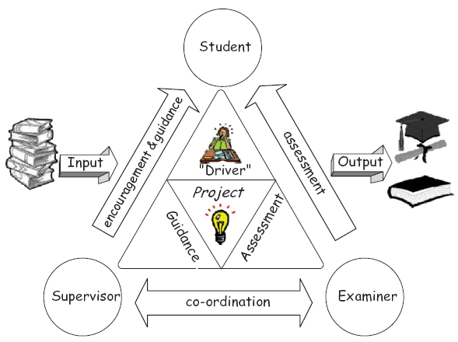
Roles

Slide 30
Duties of a Supervisor
Asses the project’s idea
Help you select a project idea.
Assess your progress through the project
Determine your suitability to continue
Guide your work.
Guide you in the preparation of your proposal and report.
Choose your examination committee.

Slide 31
Duties of students
Project Planning:
Define clear project goals and objectives.
Develop a project plan with a timeline and milestones.
Identify the scope of the project and any constraints.
Research and Literature Review:
Conduct thorough research on the chosen topic.
Review relevant literature and previous work in the field.
Identify gaps in existing knowledge that the project can address.
Proposal Development:
Create a project proposal outlining the problem statement, objectives, methodology, and expected outcomes.
Seek approval from the project advisor.

Slide 32
Duties of students
Team Collaboration:
Collaborate effectively with team members.
Divide tasks and responsibilities among team members.
Ensure clear communication within the team.
Development and Implementation:
Implement the solution.
Test and validate the implementation.
Documentation:
Maintain detailed project documentation, including research notes, code documentation, and design documents.
Create a comprehensive project report or thesis that outlines the project's methodology, results, and conclusions.

Slide 33
Duties of students
Presentation and Communication:
Prepare and deliver presentations to mentors, or evaluators to communicate project progress and findings.
Present the final project outcomes, conclusions, and recommendations clearly and effectively.
Discuss the project's significance and implications.
Respond to questions and feedback effectively.
Problem-Solving:
Address challenges and obstacles that arise during the project.
Adapt to changing circumstances or unexpected issues.
Time Management:
Manage time effectively to meet project deadlines and milestones.
Prioritize tasks and allocate time for research, development, and testing.

Slide 34
Duties of students
Adviser/Mentor Interaction:
Regularly communicate with the project adviser or mentor for guidance, feedback, and support.
Seek clarification on project-related questions or concerns.

Slide 35
Using your supervisor effectively
Prepare for your meetings.
What progress you have made since the last meeting
What problems have you encountered?
What do you intend to do next – is this suitable? Has your supervisor any other suggestions?

